Slide 1

OSLO Air and Water:
Business Working Group
Welcome!
Thursday December 17 2020
Virtual working group – Microsoft Teams

Slide 2
Purpose of today
Provide an introduction on the OSLO Air & Water project and co-create on possible use cases for the thematic workshops
What are relevant initiatives to take into consideration?
What’s the scope of the data standardisation initiative? What are the use cases and what do want to measure and which data do we need?

Slide 3
Agenda
Welcome and introduction
Recap: what did we do in the previous workshop?
Different “levels of information”: brainstorming
Fiware vs ISO O&M vs SOSA: a comparison
A first attempt for the model: feedback and brainstorming
Next steps

Slide 4
Practicalities
Audience sound is muted by default.
Questions, comments and suggestions can be communicated via the chat function. Interaction is encouraged!
Use your hand if you want to say something.
A yes/no question can be answered simply and quickly via the chat:
Agree = +1
Do not agree = - 1
Indifferent = 0

Slide 5
Practicalities
Audience sound is muted by default
Use your hand if you want to say something
Questions, comments and suggestions can be communicated via the chat function. Interaction is encouraged!
yes/no questions can be answered via chat:
Agree = +1
Do not agree = - 1
Indifferent = 0

Slide 6
Welcome and introduction

Slide 7
Who’s in the room?

Slide 8


Scope of the project
Design a semantic interoperability framework for sharing and publishing environmental data
Develop a sustainable vocabulary and application profile for water and air quality.
Additional context from the draft charter
Open & Agile Smart Cities (OASC)
The process of developing an OSLO standard for the exchange of information about air and water.
Model the data semantically and standardise the structure of air and water data
This will make it possible to semantically enrich data streams, which will make air and water data easier to find and understand, as well as better combinable with other data sources.
The vocabulary is build up based on international standards, in line with the applicable EU regulations.
ODALA
OSLO trajectory
Flanders Information Agency
Notes:
Verschillende elementen binnen de draft charter, focus ligt nu op scope afbakenen en use cases definiëren. Erna wordt de charter verder aangevuld.

Slide 9



What did we do in the previous workshop?
OSLO introduction
Semantic interoperability
Technical interoperability
Share
Reuse
Showcasing existing standards and use cases
SSN: Semantic Sensor Network
SOSA: Sensor, Observation, Sample, and Actuator
SAREF: Smart Applications REFerence
FIWARE
OPEN DEI
Brainstorm exercise
What is the scope of the use case?
What do you want to measure in the use case?
What data do you need prior and post the use case?

Slide 10
Different “levels of information”

Slide 11

OASC Minimal Interoperability Mechanisms Enabling green-digital services for cities and communities
Gert De Tant
Technical Architect
gert@oascities.org

Slide 12
OASC brings together smart cities & communities worldwide to shape the global market for digital services

Slide 13
What is minimally needed for cities and communities to exchange solutions, services, and data?

Slide 14
Minimal Interoperability Mechanisms (MIMs)
Adopted by 150 cities
Minimal Interoperability Mechanisms (MIMs) are universal tools for achieving interoperability of data, systems, and services between cities and suppliers around the world.
MIMs are:
Points of interoperability in technical architecture (i.e city platform)
Inclusive list of baselines and references (i.e. open standards and APIs)
Based on consensus among cities
Vendor-neutral and technology-agnostic

Slide 15
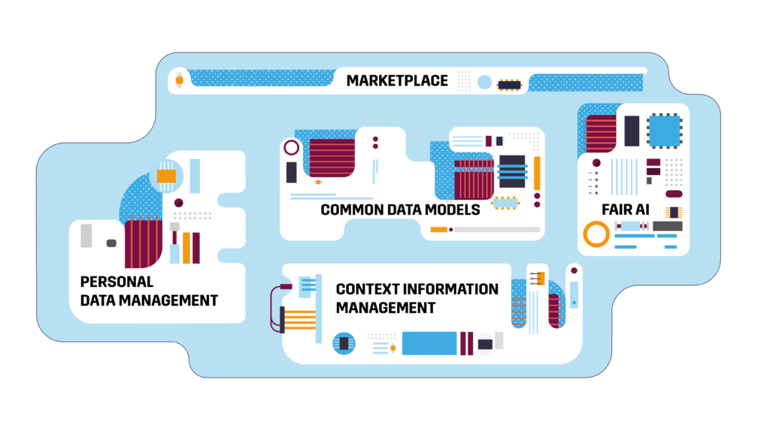
Minimal Interoperability Mechanisms
Formally adopted by +150 cities

Slide 16
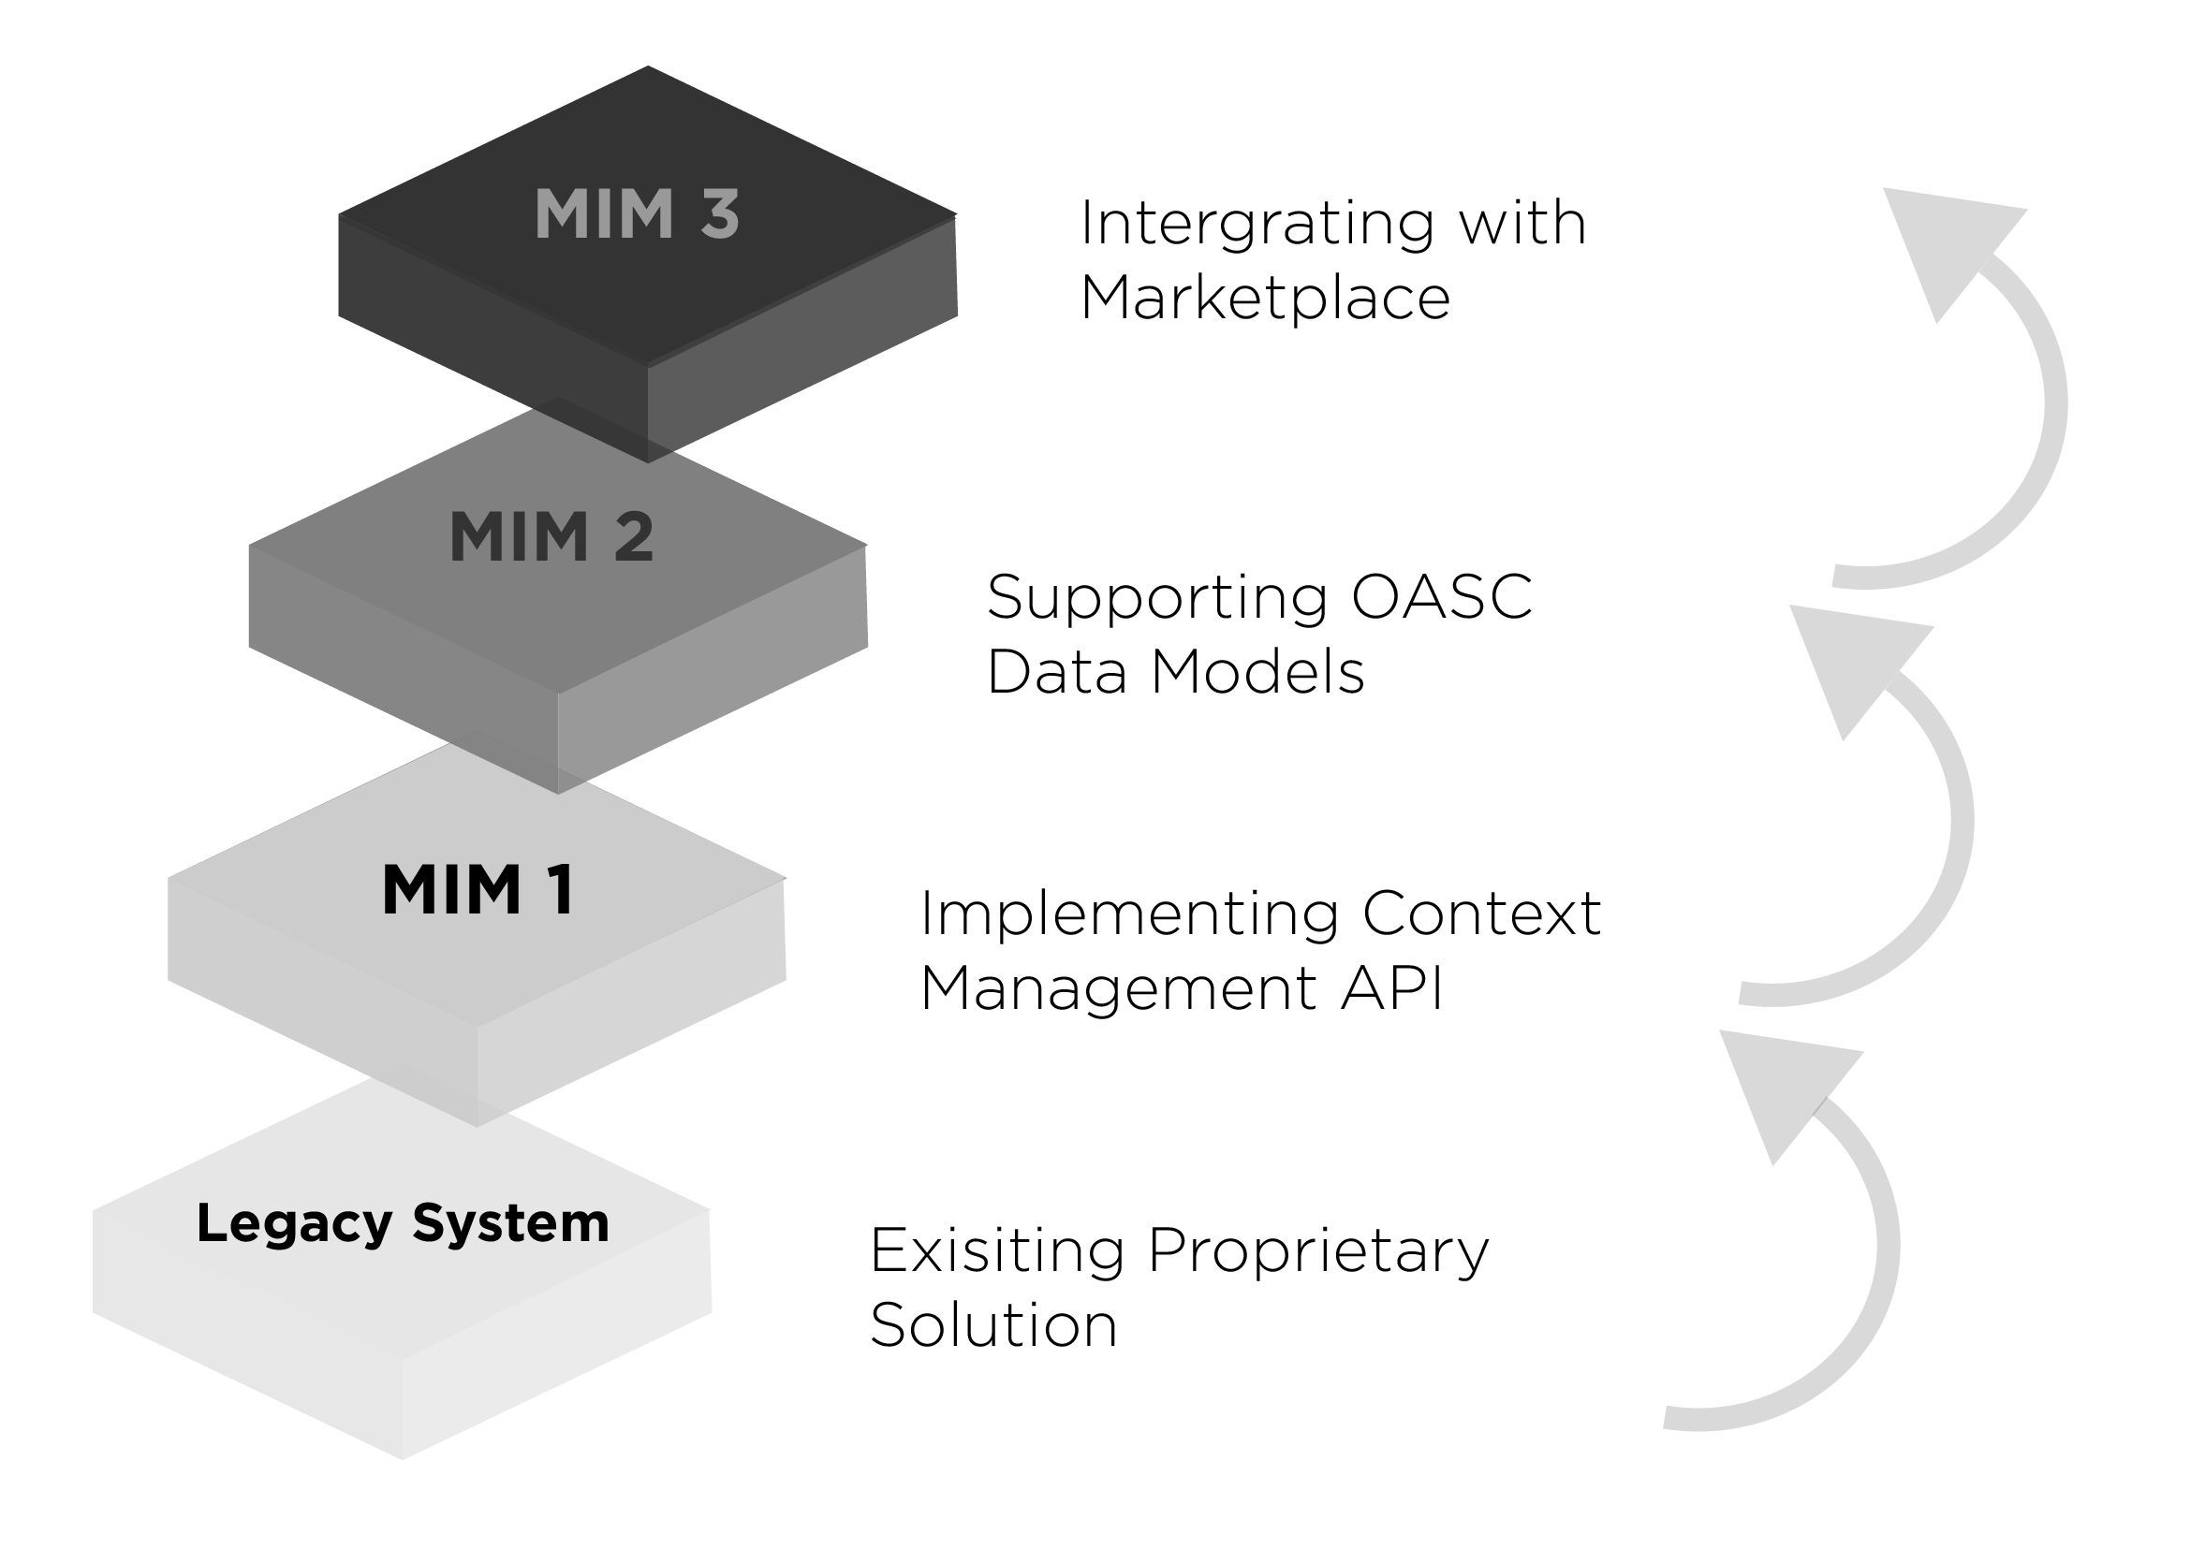
Minimal Interoperability Mechanisms
MIM 1: Context Information Management
MIM 2: Common Data Models
MIM 3: Ecosystem Transactions Management
MIM 4: Personal Data Management (proposed by Helsinki)
MIM 5: Fair AI (proposed by Amsterdam)
Notes:
The demand side is an essential element of any market, and

Slide 17
OASC Interoperability Mechanisms
MIM
Interoperability Point | Description
Context Information Management | This API allow to access to real-time context information from the different cities. It is based on ETSI CIM NGSI-LD and the previous OMA NGSI
Shared Data Models | Guidelines and catalogue of common data models in different verticals to enable interoperability for applications and systems among different cities. The models are based on for example SAREF, DATEX II, GSMA, schema.org, ..
Ecosystem Transaction Management (“Marketplace”) | It exposes functionalities such as catalogue management, ordering management, revenue management, Service Level Agreements (SLA), license management etc. Complemented by marketplaces for hardware and services. Based on the TM Forum Business API, Fiware business EcoSystem and market place enabler API
Personal Data Management | Mechanisms allowing individuals and communities to manage and make informed decisions about the use of information derived from their personal data. Aligning the initiatives like MyData.org, SOLID and IHAN
Fair AI | Mechanisms allowing inspection of automated decision making. Based on the work from Amsterdam and Helsinky regarding AI registry.
1
2
3
4
5
MIM 1-3 Adopted by OASC Council of Cities January 16, 2019
MIM 4-5 Proposed as work items

Slide 18
OASC MIMs: Status
20+ operational deployments worldwide
Including Milan, Vienna, Porto, Helsinki, Santander, Eindhoven, Antwerp, Geneva, Manchester, Seongnam, Bordeaux
140+ formal adoptions worldwide
Including Stavanger, London, Amsterdam, Brisbane, Edinburgh, Rio De Janeiro, Buenos Aires, Leon, Ghent, Almere, Sarajevo, Tampere
Pending: Tokyo, Fukuoka, Osaka, Yokohama, Dubai, Montreal, Toronto, Chennai, Pune, Hyderabad, Shanghai, Yinchuan, Guadalajara
29 countries
Currently average of 4.8 cities per country

Slide 19
MIMs
Benefits
Benefits for Cities
Choice, flexibility, efficiency, value-for-money, independence, economic development
Benefit for Businesses
Scale, agile development and deployment
Benefit for all
Reduced risk, increased investments, innovation

Slide 20
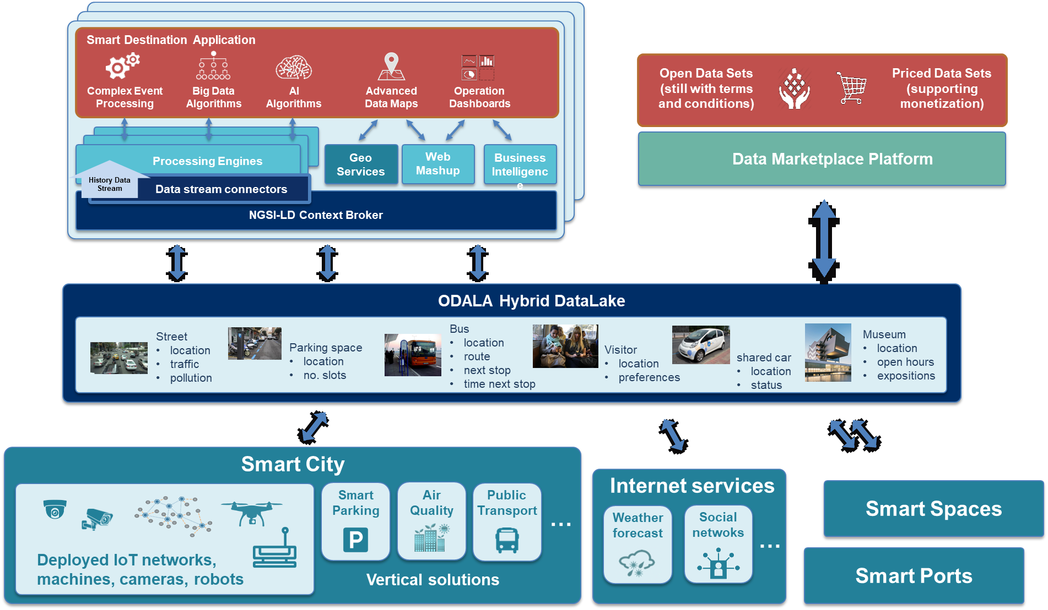
ODala
Purpose

Slide 21
ODala
Partners
Cities/regions: Kiel (Germany, Coordinator), Heidelberg (Germany), Cartagena (Spain), Saint-Quentin (France), Faubourg Numérique (France), Flanders Information Agency (Belgium), Flanders Information Agency (Belgium), Digipolis Antwerp (Belgium)
Companies: NEC Laboratories Europe (Germany), HOP Ubiquitous (Spain), Sirus (Belgium), Vero City (Germany), Contrasec (Finland)
Research institutes: imec (Belgium),
NGOs: FIWARE Foundation (Germany), Open & Agile Smart Cities (Belgium)

Slide 22
CITYxCITY
Empowering Cities & Communities

Slide 23

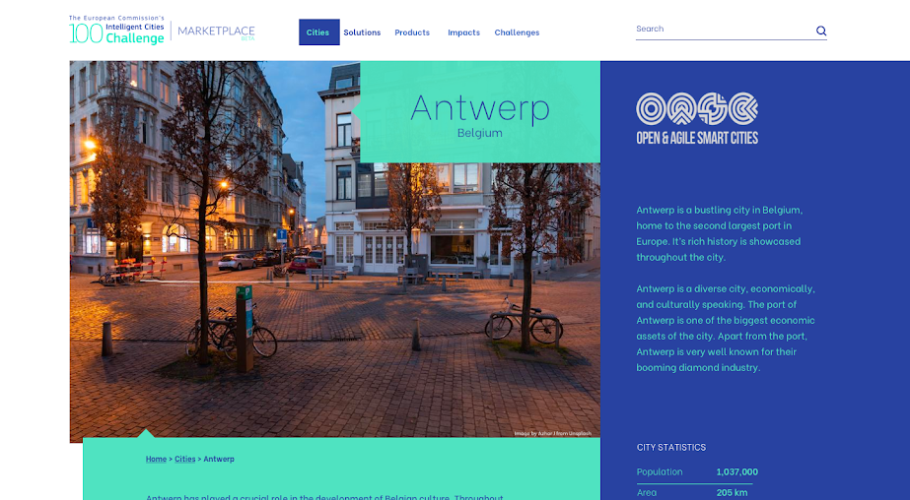


CITYxCITY
Connecting Cities. Empowering Communities
www.citybycity.com
13-15 January 2021
Coming Soon
Coming Soon

Slide 24
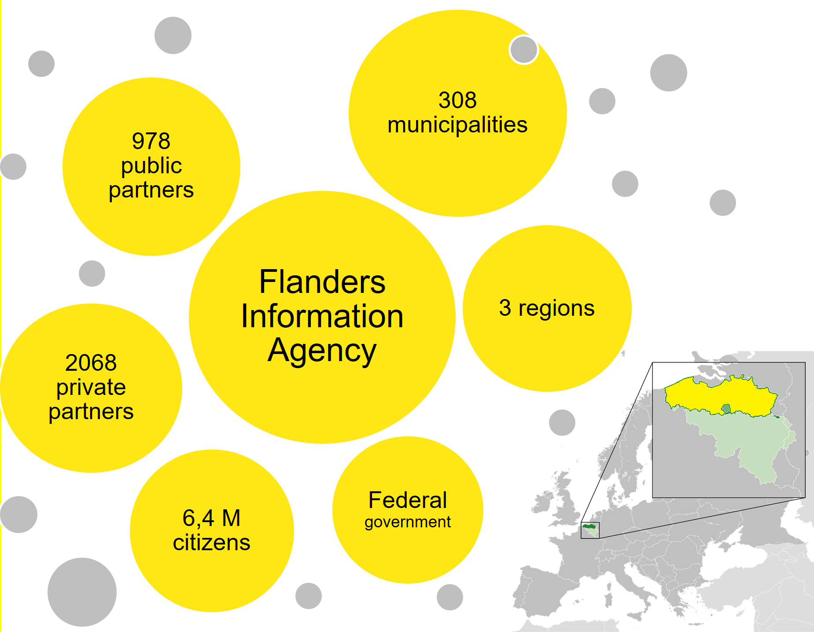
Informatie Vlaanderen – at the crossroads

Slide 25
Open Standards for Linked Organisations (OSLO)
X

Slide 26
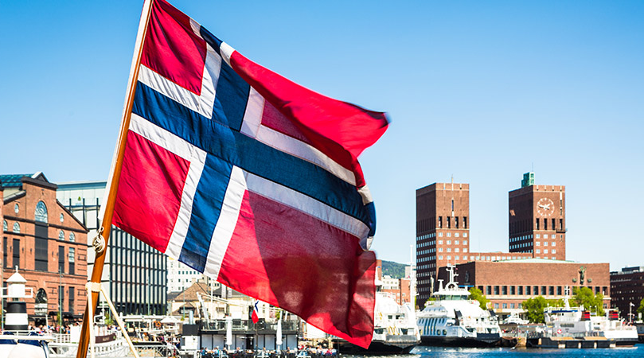

Slide 27
Open Standards for Linked Organisations

Slide 28
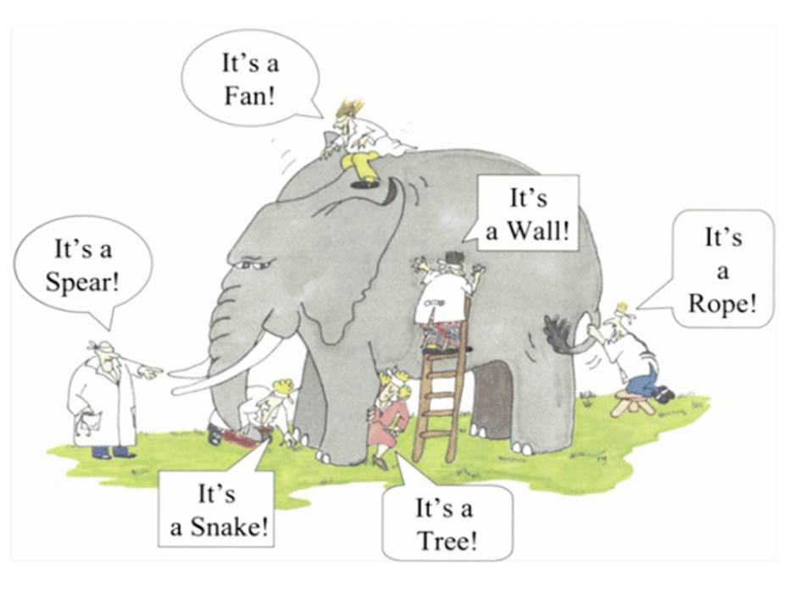
Applications look at the real world from different perspectives
Information is structured/modelled from 1 perspective
Authentic data sources exist as silos
Multiple costs to link information
Impact on service quality and efficiency

Slide 29

Interoperability is the ability of different autonomous organizations or systems to communicate and collaborate with each other.

Slide 30
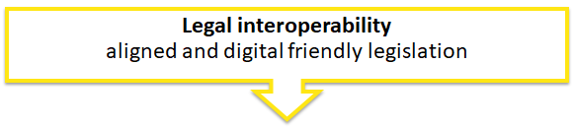
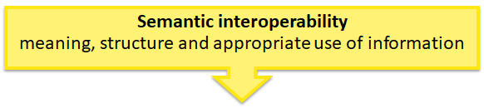
Levels of interoperability
Legal interoperability
Organizational interoperability
}
Semantic interoperability
OSLO
Technical interoperability

Slide 31





OSLO
Semantic interoperability
Technical interoperability
Tools
Support & Governance
Use cases

Slide 32
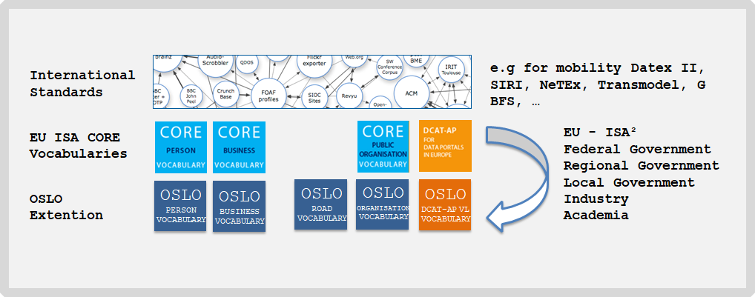
Share and reuse
e.g. INSPIRE

Slide 33
Status of OSLO in 2020
35
18
3
Recognized standards
Candidate standards
Standards in development

Slide 34
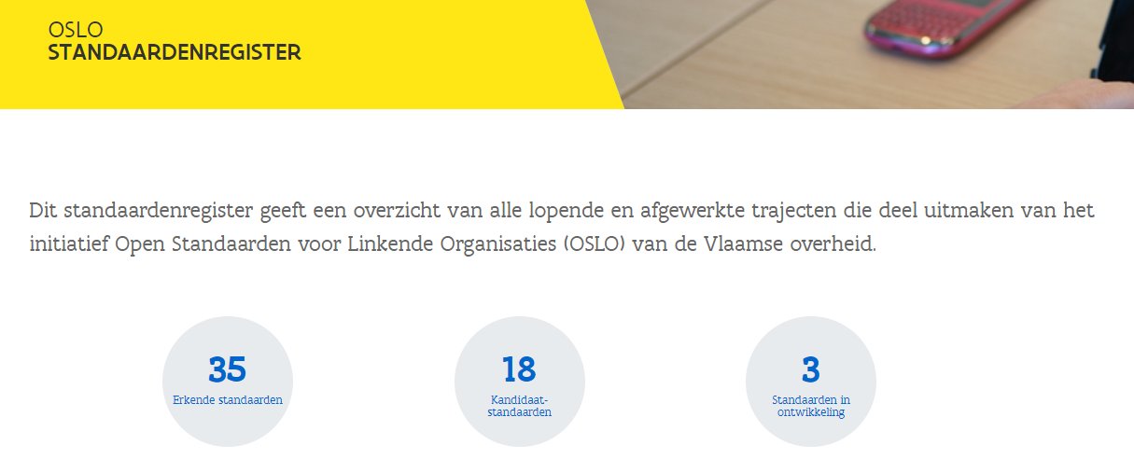
An example

Slide 35
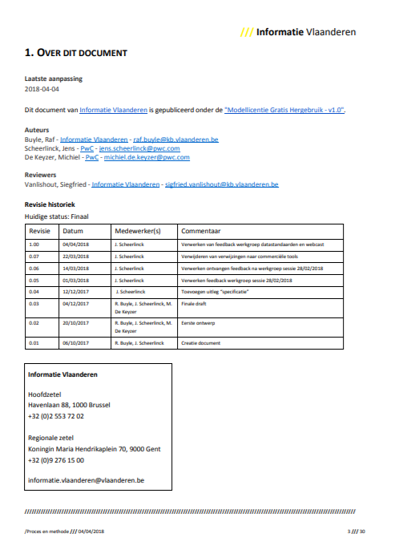
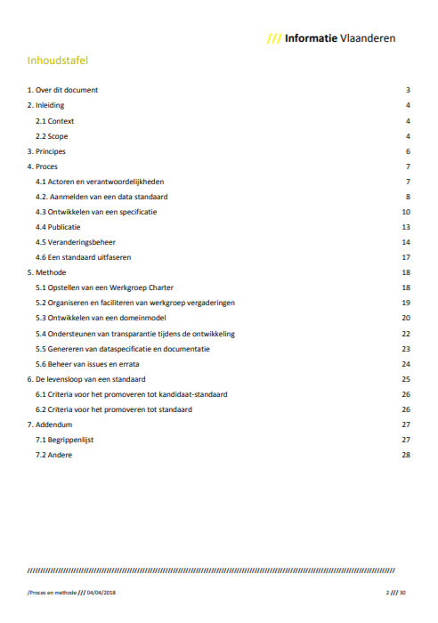
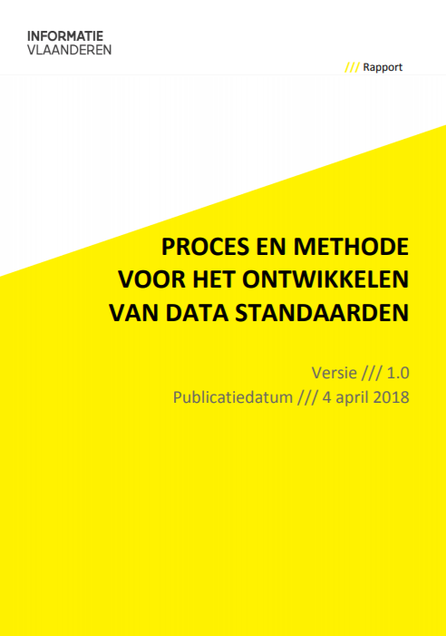
Process and method
Scalable process for logging in, developing, modifying and phasing out data standards
Notes:
Icons made by Freepik from www.flaticon.com

Slide 36
Overview of the planning
Start date: December 1st, 2020
Timing: 9 months
Today
Business Workshop
Start Public review
End Public review
Thematic Workshop
Thematic Workshop
2020
2021
December
January
February
March
April
May
June
July
August
Thematic Workshop
Implementation of draft specification
Thematic Workshop
Thematic Workshop

Slide 37
Inspiration

Slide 38
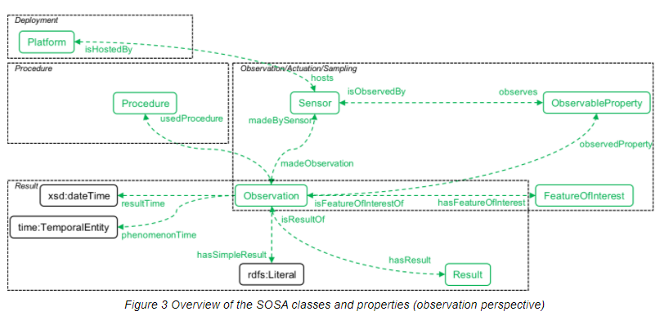
Existing standards – SSN/SOSA
https://www.w3.org/TR/vocab-ssn/

Slide 39
Existing standards – SAREF
Smart Appliances REFerence ontology
The SAREF family of standards enable interoperability between solutions from different providers and among various activity sectors in the Internet of Things (IoT)
SAREF4CITY provides a common core of general concepts for smart city data for the IoT. This also includes use cases for air quality monitoring.
SAREF4INMA (Smart Industry & Manufacturing)
SAREF4AGRI (Agriculture)
SAREF provides the semantic interoperability necessary to share the information carried by the data.

Slide 40


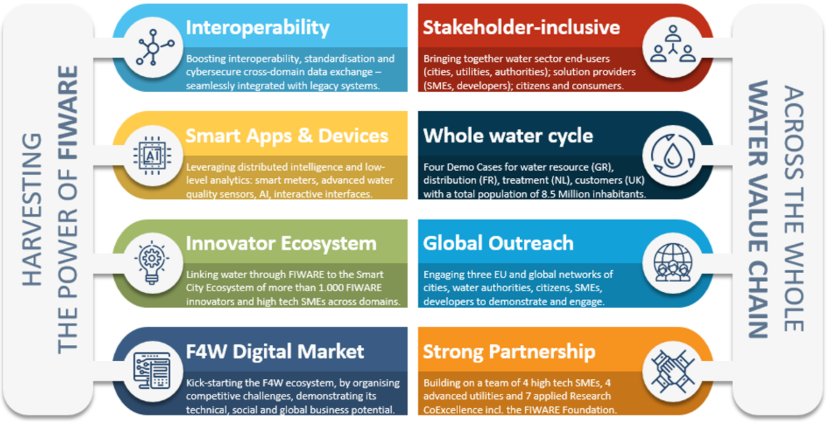
Existing standards - Fiware
Description
Relevance for this project
Smart solution platform,
Funded by the EC as a major flagship PPP
Supports SMEs and developers in creating the next generation of internet services, as the main ecosystem for Smart City initiatives for cross-domain data exchange/cooperation and for the NGI initiative. (bron: https://www.fiware4water.eu/)
Fiware4Water
Link the water sector to FIWARE
Interoperable and standardised interfaces
Both for water sector end-users and solution providers

Slide 41
Existing standards – OPEN DEI
Description
Relevance for this project
Focuses on “Platforms and Pilots” to support the implementation of next generation digital platforms in four basic industrial domains: manufacturing, agriculture, energy and healthcare
Part of the Horizon 2020 programme
Different focus areas from Open DEI that could useful for this project:
Platform building
Data ecosystem building
Large scale piloting
Standardisation

Slide 42


Use case – Saint-Quentin
Scope
Modernize the management of stadium maintenance operations, especially watering and mowing, through a smart watering solution
Added value
FIWARE was a crucial element to achieve a sustainable smart watering solution, it allowed to fulfil 3 technical conditions simultaneously:
Define a watering strategy based on the real water needs of the grass
Gather additional information in order to identify the appropriate watering
Apply the watering plan remotely and automatically

Slide 43


Use cases - Irrigation for Agriculture
Scope
Optimize the amount of water used for farming
What do we want to measure?
Consumption of water used real time and daily, quality of the water live, temperature, soil moisture, stop/start of the irrigation system, river or underground available water quantity, predictability (weather and amount of water available)
What data do we need?
Live data from the different sensors mentioned above, adding predictability

Slide 44
Use cases - Water quality: drinkable water
Scope
Remotely measuring the water quality directly at the source (source or ground water)
What do we want to measure?
Water drinkability based on the criteria for each region/country
What data do we need?
Live data:
PH, chlorate, turbidity temperature, bacteria, amount of water, ect.

Slide 45
Use cases - Predictive maintenance of water assets
Scope
Optimize CAPEX and OPEX on drinkable, waste and hydropower asset systems
What do we want to measure?
Operational data from specific equipment that can help us to detect anomalies and plan maintenance interventions
What data do we need?
Opening time of a valve, vibration, noise, …

Slide 46
Brainstorm exercises

Slide 47
Exercise - Setting the boundaries
What is the scope of possible use cases?
e.g. Policy making and follow-up, operational reporting, application development, modelling, research, statistics etc.?
What problem do we want to solve?
What do we understand under air and water quality?
What do we want to measure?
For which domains (e.g. for water: watercourses? rainwater? sewage? soil water? ... )
Which data elements (objects) do we need?
What kind of information are we talking about: real-time of static?
What kind of filters do we need to be able to apply (watercourse, area, ..)?

Slide 48
Short break
Let’s take a 5 minute break, while we process your input

Slide 49
Next steps

Slide 50
Next steps
Thematic workshop on the 12th of January (13h-15h30 CET) Don’t forget to subscribe!
https://overheid.vlaanderen.be/opleiding/oslo-air-and-water-model
Today
Business Workshop
Start Public review
End Public review
Thematic Workshop
Thematic Workshop
2020
2021
December
January
February
March
April
May
June
July
August
Thematic Workshop
Implementation of draft specification
Thematic Workshop
Thematic Workshop

Slide 51
Next steps – In the meanwhile...
Process the input from the brain storm exercise
Circulate the main findings of this workshop. Feedback is appreciated!
Further research and prepare the first thematic workshop
Capture further input through GitHub!

Slide 52

Feedback & collaboration
Feedback can be provided by email to the following people:
annelies.decraene@vlaanderen.be
michiel.dekeyzer@vlaanderen.be
dries.catteceur@vlaanderen.be
Feedback/input can be provided through GitHub: https://github.com/Informatievlaanderen/OSLOthema-airAndWater
Please provide us with your username so we can invite you!

Slide 53

Are there any questions left?

Slide 54
Thanks!

